Slide 1
GDHP Interoperability Workstream
IPS Work Group Meeting
June 15, 2023

Slide 2
Meeting Agenda
Agenda Item | Facilitator(s)
Opening Remarks (2 minutes) | Matt Rahn, Acting Director of Standards Division, ONC, USA
Recap: FHIR DevDays 2023 (10 minutes) | John D’Amore, President of More Informatics & GDHP Interoperability Work Stream Contractor
National FHIR IG Discussions (10 minutes) | John D’Amore, President of More Informatics & GDHP Interoperability Work Stream Contractor
Mini-Connectathon Planning (5 minutes) | All GDHP Participants
GDHP Summit Planning (5 minutes) | Aisha Hasan, Head of Global Health IT, ONC, USA
Open Discussion (10 minutes) | All GDHP Participants
Next Steps & Meeting Closure (3 minutes) | Aisha Hasan, Head of Global Health IT, ONC, USA

Slide 3
Opening Remarks
Matthew Rahn,
Acting Director of Standards Division, ONC, USA

Slide 4
Recap of FHIR DevDays 2023
John D’Amore, President of More Informatics & GDHP Interoperability Work Stream Contractor

Slide 5
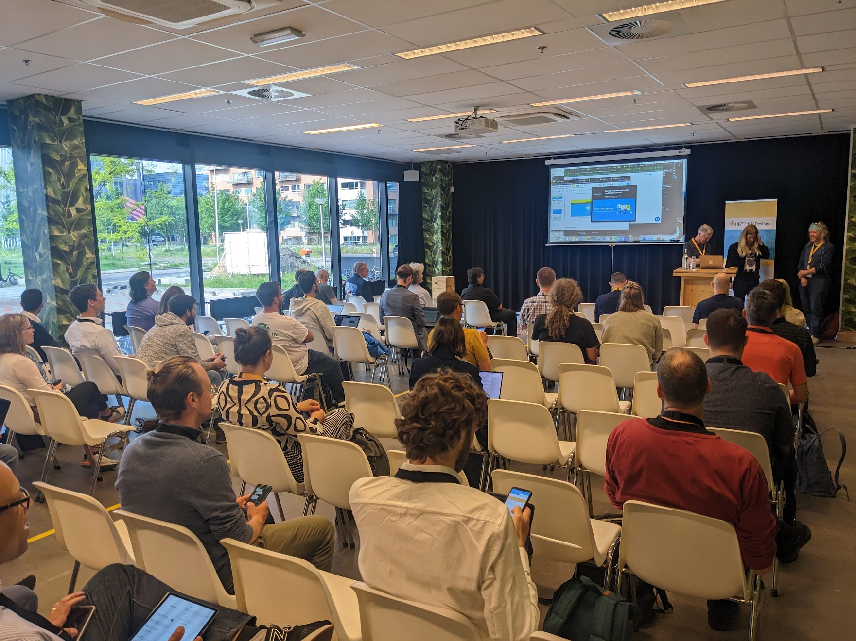
FHIR DevDays presentations on IPS
HAPI IPS Support, presented by James Agnew and Rob Hausam, pictured on left (June 7 9am CET, recorded)
Patient Mediated Exchange of IPS Using SMART Health Links by John D’Amore (June 7 1:15pm CET, not recorded)

Slide 6

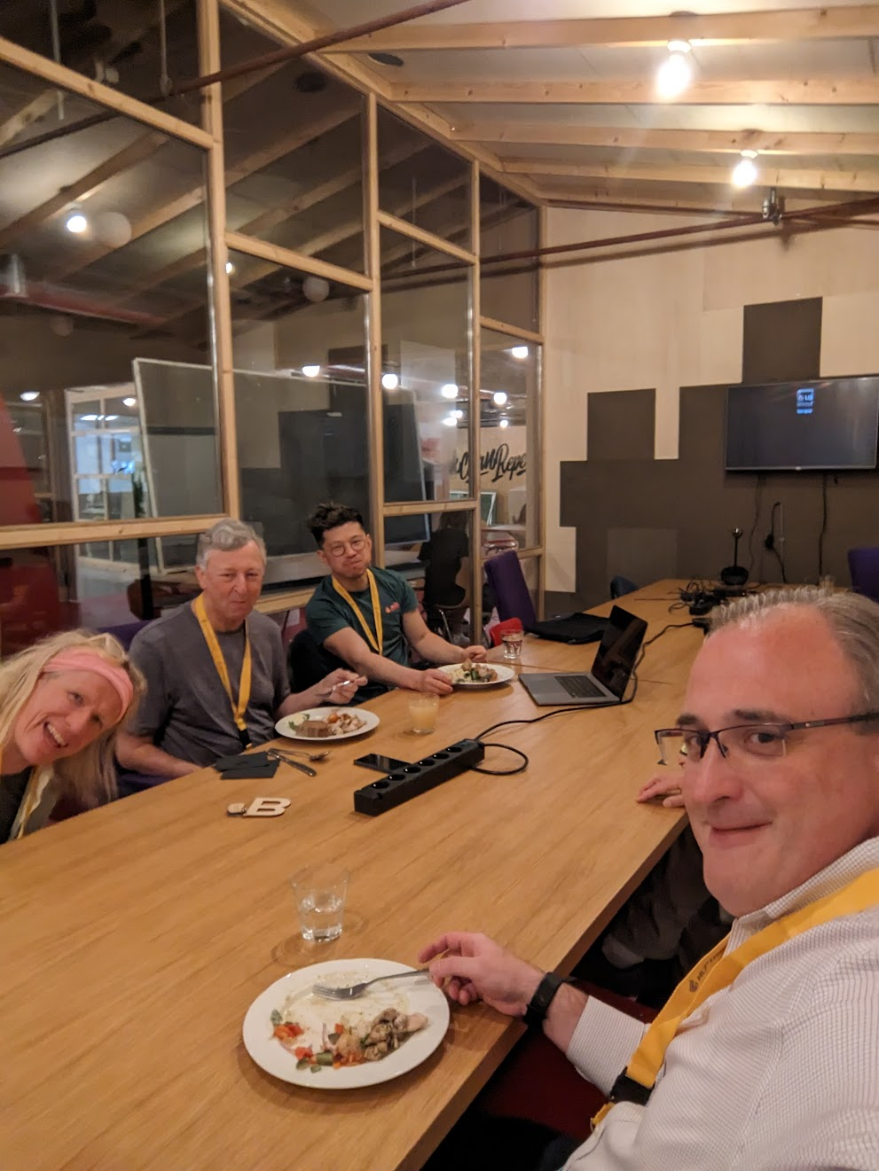

Other Related DevDays Discussions
James Agnew, Smile Digital Health
Rob Hausam, Hausam Consulting
Jing Tang, Google
Bashir Sadjad, Google (not shown)
Grahame Grieve, HL7 (not shown)
Result of discussion was a four-step process of exploration planned by Google

Slide 7
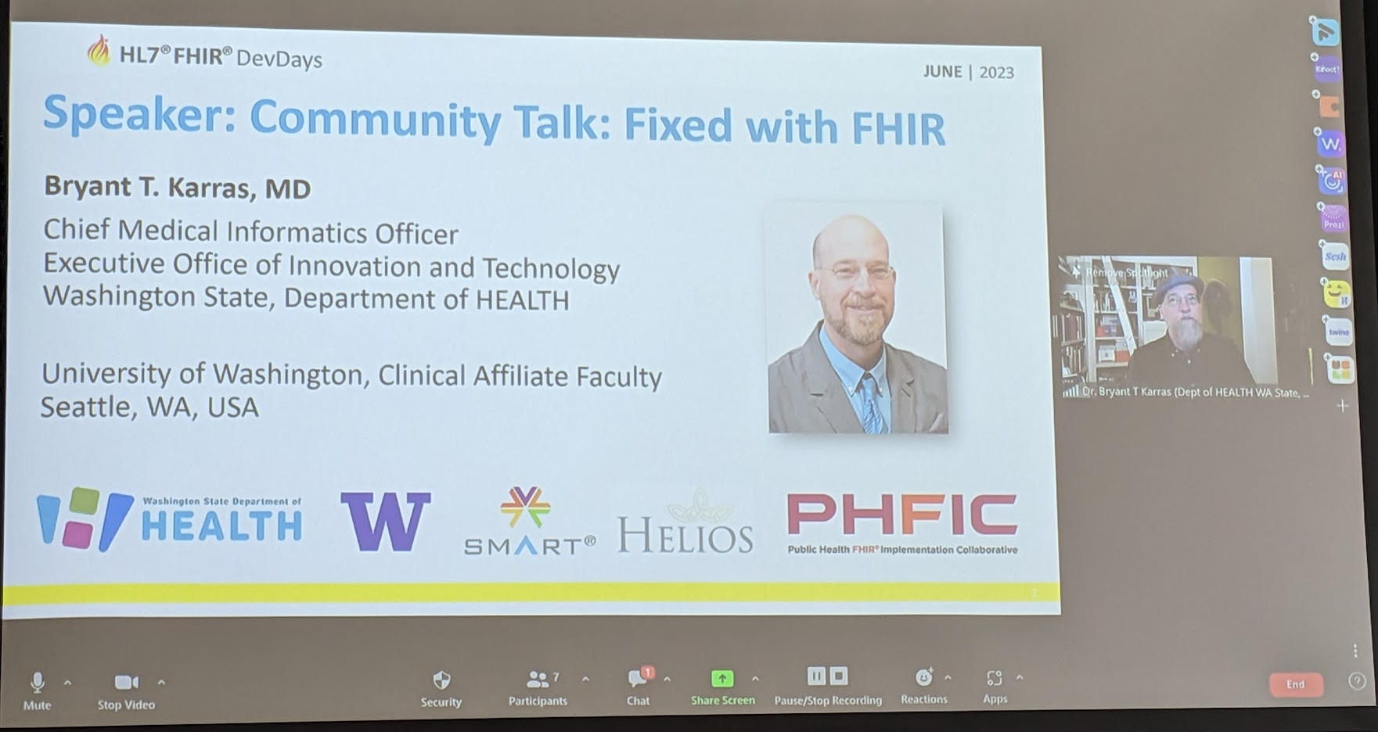
Other Related DevDays Presentations
Washington presentation on usage of SMART Health Cards. Potential future of SMART Health Links discussed
Youtube video (by Microsoft) on SMART Health Cards https://www.youtube.com/watch?v=YVCah-AahbU&t=5s

Slide 8
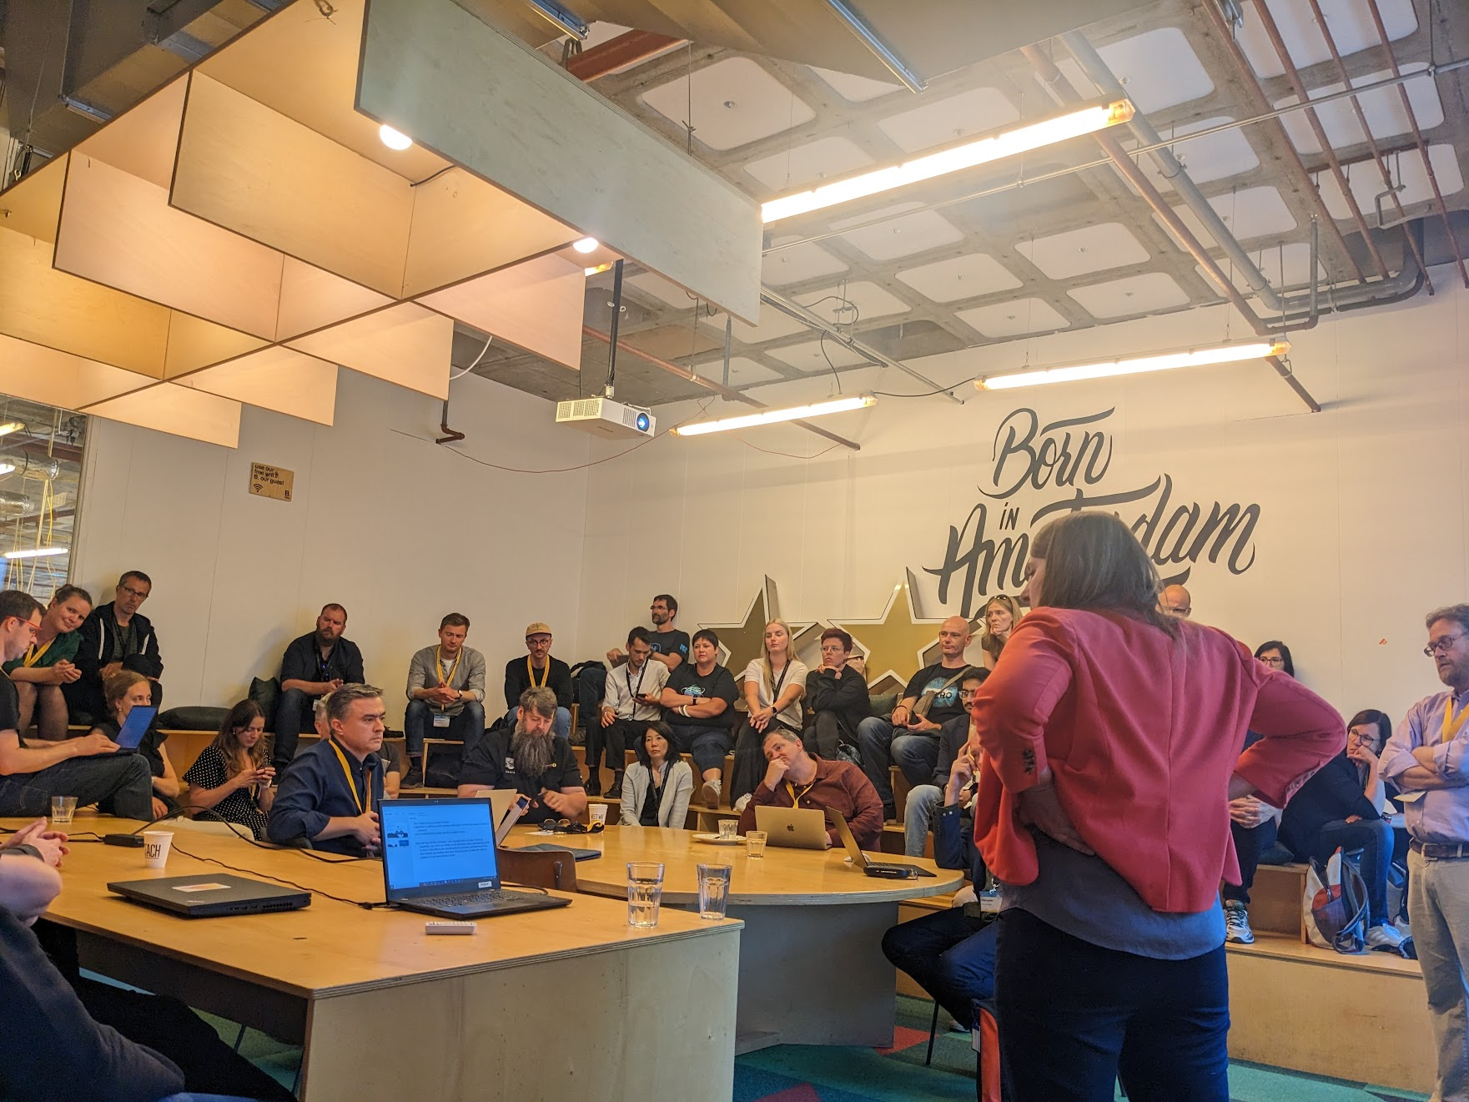
FHIR DevDays 2023
Tuesday and Friday Presentations / Discussion Groups, hosted by Sheridan Cook (Accenture / Health Infoway) and Isaac Vetter (Epic)
Decision to open new chat.fhir.org stream (https://chat.fhir.org/#narrow/stream/392078-National-IGuides) and to host monthly calls

Slide 9
National FHIR IG Discussions
John D’Amore, President of More Informatics & GDHP Interoperability Work Stream Contractor
Matthew Rahn,
Acting Director of Standards Division, ONC, USA

Slide 10
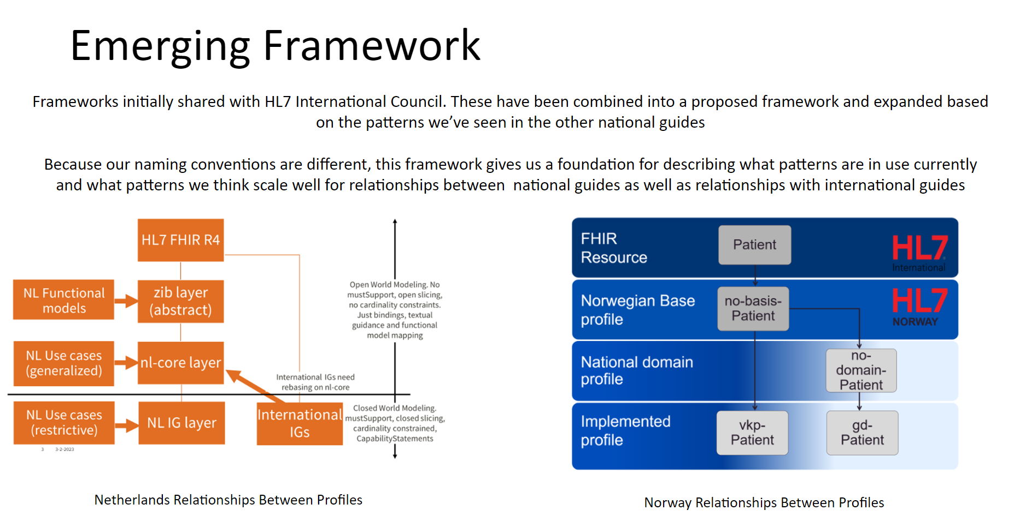
National IG Discussion (IPS and IPA)

Slide 11
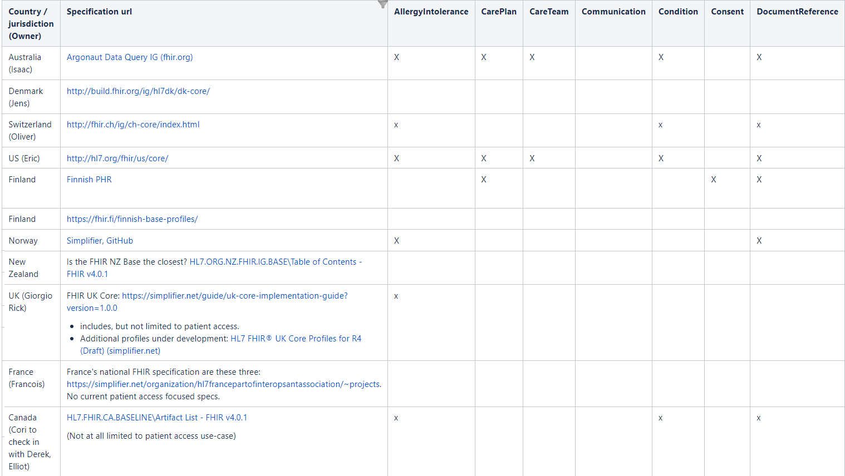
Comparison of National FHIR IGs
More columns and rows not shown but available on Confluence link below
Confluence Page (from IPA Project Work)
https://confluence.hl7.org/display/PC/International+Patient+Access
Working Document (from HL7 International Council Presentation)
https://docs.google.com/presentation/d/1YMVkSVdt_K7_msiiGRE1UEE45LzDZQgz88pTdwE545U/

Slide 12
Links to FHIR IGs (based on IPA Project work)*
GDHP Members
AU: https://build.fhir.org/ig/hl7au/au-fhir-base/
CA: https://build.fhir.org/ig/HL7-Canada/ca-baseline/
CH: http://fhir.ch/ig/ch-core/index.html
EE: https://build.fhir.org/ig/HL7EE/ig-ee-base/
FR: https://simplifier.net/frenchprofiledfhirar
IT: http://www.hl7.it/fhir/base/index.html
JP: https://jpfhir.jp/fhir/core/index.html
NL: https://simplifier.net/nictizstu3-zib2017
GDHP Members (continued)
NZ: http://build.fhir.org/ig/HL7NZ/nzbase/
UK: https://simplifier.net/guide/uk-core-implementation-guide?version=1.0.0
US: http://hl7.org/fhir/us/core/
Non-GDHP Members
BE: https://www.ehealth.fgov.be/standards/fhir/core/
DE: https://simplifier.net/basisprofil-de-r4
DK: http://build.fhir.org/ig/hl7dk/dk-core/
FI: https://fhir.fi/finnish-base-profiles/
NO: https://simplifier.net/hl7norwayno-basis
* Note that these are links based on IPA work and may not be latest or definitive national IGs

Slide 13
Mini-Connectathon Planning
All GDHP Participants

Slide 14
GDHP Mini-Connectathon
Tuesday July 25th
^{Potential topics?}

Slide 15
GDHP Summit Planning
Aisha Hasan,
Head of Global Health IT, ONC, USA

Slide 16
Open Discussion
All GDHP Participants

Slide 17
Closing Remarks
Aisha Hasan,
Head of Global Health IT, ONC, USA

Slide 19
Appendix

Slide 20
IPS Work Group Approved Items
These items have been approved by the GDHP Interoperability Work Stream’s IPS Work Group.
Please let Matt Rahn & Aisha Hasan (Matthew.Rahn@hhs.gov, Aisha.Hasan@hhs.gov & ONCGlobalHealthIT@hhs.gov) know if you have additional feedback to be included in these items.

Slide 21
IPS Policy, Legal, and Cyber Security Implications
During the April 1, 2021 meeting, the GDHP Interoperability Work Stream’s IPS Work Group decided to advance the IPS standard via patient-mediated exchange for piloting and production.
Please let Matt Rahn & Aisha Hasan (Matthew.Rahn@hhs.gov, Aisha.Hasan@hhs.gov & ONCGlobalHealthIT@hhs.gov) know if your nation has any obstacles or challenges for this path forward.

Slide 22
IPS Use Cases
Document bundle for cross-border (international) data exchange
Cross-border exchange infrastructure (e.g., European cross-border exchange)
Mobile devices
Transfer of Care
Referral to specialist
IPS profiles used as a foundation for other specialized specifications
Regional, national, local patient summaries
Vaccination data (for COVID-19 or future pandemics)
Cancer survivorship passport
Rare diseases (notification/awareness?)
Please let Matt Rahn & Aisha Hasan (Matthew.Rahn@hhs.gov, Aisha.Hasan@hhs.gov & ONCGlobalHealthIT@hhs.gov) know if there are additional use cases that should be included here.

Slide 23
Key Steps for GDHP Members’ Implementation of IPS
Steps (can occur concurrently) | Leads
1. Identify GDHP members that will participate in the 2021 pilot projects and the next wave of 2022 production or pilot projects | GDHP IPS Work Group
2. Determine IPS health data flow within the nation for GDHP members with multiple provinces/states. | GDHP IPS Work Group Members (as applicable)
3. Discuss each GDHP members’ local infrastructure to build on to use IPS in a local setting for a non-resident and generate IPS from the individuals’ primary health care provider’s EHR | Each GDHP member for their nation. Each GDHP member will present on this during an IPS Work Group meeting.
4. Conduct a broad gap analysis between the IPS and each GDHP members’ local infrastructure specifications. Determine to what extent the requirements of the IPS can be met by the local infrastructure. | Each GDHP member for their respective nation. Each GDHP member will provide feedback during IPS Work Group meetings.
5. Identify each GDHP members’ local infrastructure to be used to exchange the IPS (e.g., national contact point, personal mobile device). | Each GDHP member for their nation
6. Identify and address GDHP members’ local infrastructure, security, consent, authentication, policy, etc. constraints to exchanging the IPS. | GDHP IPS Work Group
7. Identify GDHP members who will participate in the 2021 pilots. GDHP members will have a better understanding of the time commitment to engage in a pilot project and to move to production. | GDHP IPS Work Group
8. Update the IPS based on pilot testing to ensure better alignment and exchange of data within the IPS standard. | GDHP IPS Work Group

Slide 24
IPS Success
GDHP members agree on path for IPS implementation globally, and each member implements IPS in their nation.
IPS is implemented so individuals’ health data is available and usable by the local health care provider and health system for providing care to the individual in another nation.
The local health care provider and health system are able to provide the individual with an updated IPS record, including the data from the care they received in-country.
Individuals’ primary health care providers can readily and easily generate an IPS document or specialized subset (e.g., vaccination record) based on the individuals’ clinical data in the EHR.
Individuals’ IPS records are provided, or easily accessible, to them by a cross-border health care provider as needed.
Individuals can carry their health data in an IPS document (or specialized subset) on their electronic (mobile) device.
Nations without information health systems can easily access their IPS records via paper formats.
GDHP nations agree on IPS maintenance of health data standards and mapping, and they implement it globally and in their nations.
GDHP nations agree on individuals’ patient consent authentication when sharing data across borders.

Slide 25
IPS Work Group Goals
End of 2021: At least 10 countries and territories are able to exchange and use IPS data with one or more other country(ies) in a pilot project.
End of 2022: At least 20 countries and territories are able to exchange and use IPS data with one or more other country(ies) in production (at least 10 countries) and the remaining countries in pilot use.
Ultimate Goal: All GDHP countries and territories are able to exchange and use IPS data.
IPS Work Group Goals
This may undergo an update based on Interoperability workstream feedback

Slide 26
IPS Work Group Milestones
IPS Work Group Milestones
2021:
Connectathons – IPS Tracks
Jan 2021 HL7 FHIR Connectathon
Mar 2021: IHE NA Connectathon
May 2021: HL7 FHIR Connectathon
May 2021: GDHP FHIR Connectathon
Jun 2021: GDHP FHIR Connectathon
Sep 2021: HL7 FHIR Connectathon
Oct 2021: GDHP FHIR Connectathon
Present on the IPS
Apr 2021: GDHP Summit
Aug 2021: HIMSS Conference
Nov 2021: SNOMED International
.
Demos & Articles
HL7 Blog
IPS Viewer Hosted (www.ipsviewer.com)
UK IPS Prototype Development
2022:
Connectathons – IPS Tracks
Jan 2022: GDHP FHIR Connectathon
Mar 2022: Canadian Projectathon (IPS-related)
Apr 2022: Trans-Tasman Event (IPS-related)
May 2022: HL7 FHIR Connectathon
May 2022: LACPass Connectathon (IPS-related)
June 2022: GDHP FHIR Connectathon
Sep 2022: IHE & HL7 Testing & Connectathon
Nov 2022: GDHP Connectathon (TBD)
Present on the IPS
Mar 2022 HIMSS Presentation
Jun 2022 HL7 FHIR DevDays
September 2022: SNOMED International
Demos & Articles
Healthcare Journal Publication
Demo (ips.health) at 2022 GDHP Summit
Notes:
2021 and 2022 have been very busy years in terms of advancing IPS. As a summary
Support for 5 GDHP mini-connectathons
Support for 5 HL7 multi-day connectathons (counting September 2022)
Major presentation at national and international conferences
The advancement of demos, tools, events and prototypes through many global partners

